Slide 1


Jackson Wellness Resources
Leader Toolkit

Slide 2
Recognizing Distress Among Employees
Early Signs of Distress
Person seems different
Behavior
Job performance
Motivation
Concentration
Symptoms Interfering with Daily Functioning
Trouble completing daily tasks
Difficulty performing at work
Withdrawal from others
Mental Health Crisis
Behavior that puts the person or others in danger
Overdose
Threat of suicide
Inability to care for others who may depend on him or her

Slide 3
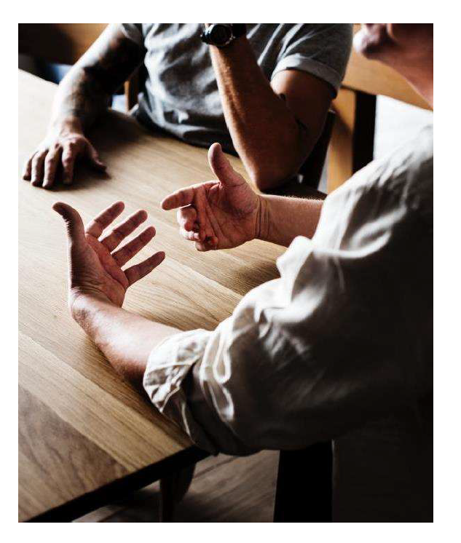
Remember to “CARE”
Consider the signs
Ask to talk
Refer to resources
Engage in follow-up
What are some of those resources?

Slide 4
CARE on Call – Lifetime Support
Tailored For Your Needs
6 Visits Per Year
786-466-8377, option 2

Slide 5
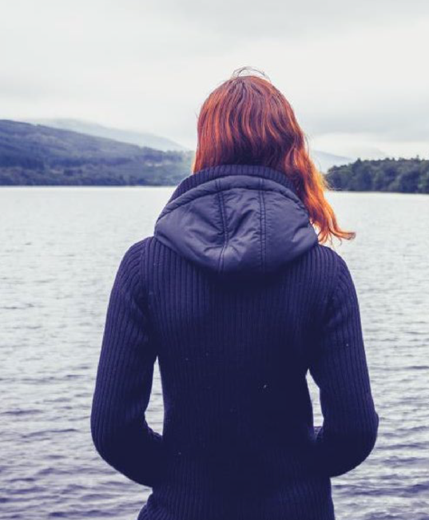
CARE on Call
What is Lifetime Support?
A starting place for addressing personal issues
A cost-free avenue of assistance to support a healthy workplace
Includes access to counseling services, work-life services such as childcare referrals, legal, and financial services, and more
Services are confidential and are not shared with your employer. There are certain required-by-law exceptions:
  If a caller reports any knowledge or suspicion of child or elder abuse or neglect
  If a caller threatens to harm themselves or others
  When the caller signs a release of information granting permission to divulge certain information

Slide 6
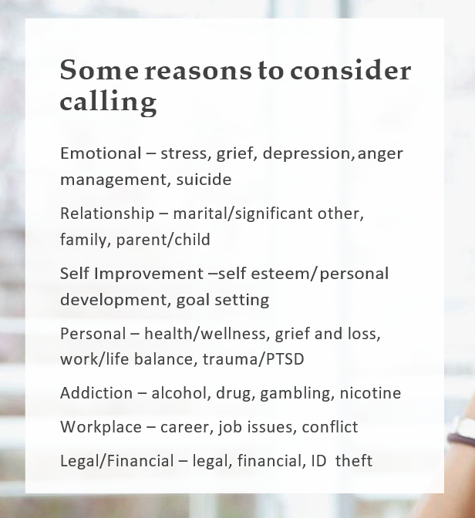

CARE on Call
Eligibility
Who’s eligible?
  You (first day of hire)
  Anyone in your household (regardless of their relationship to you, age, or health insurance coverage)
  Dependents up to age 26 whether or not they live at home

Slide 7
CARE on Call
Life and Relationships
Resource Centers
Career and Workplace
Parenting
Relationships
Aging adults
Balancing work and family
Managing life
Pets
Crisis and disaster
Staying healthy
  Fitness
  Nutrition
Self-improvement
Stress
Trauma, grief, and loss
Dealing with tough situations
Handling change
Helping your coworkers
Navigating career
Manager resources
Manager services
Mental Health and Addictions
Tools
Depression
Suicide prevention
Addictions
Mental health awareness and conditions
Mental well-being terms
Services
Monthly features
Webinars
Video library
Digital resources
Find support
Check in on you
About your benefits
  Orientation
Emotional well-being
Legal and financial
Daily life assistance

Slide 8
CARE on Call
Suggesting Our Services
Consider a Management Referral
Suggest your employee call us when:
You become aware of an employee’s personal issue
No job performance concerns exit
You want to offer proactive support
The process:
Provide employees with our contact information
No release of information is signed
You receive no communication regarding employee follow-up for treatment
Use a management referral when:
An employee has performance issues or
An employee’s behavior creates risk or liability for your organization
The process:
Call to consult with an MRC to determine how to proceed
Meet with the employee and signa. HIPAA release of information that you return to the MRC
Get follow-up information, which may include employee’s level of participation and attendance

Slide 9

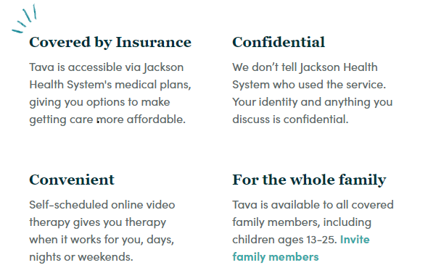
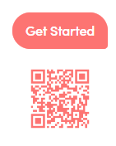
Tava: Mental Health Benefit
How Tava Works
Find the Perfect Fit: Get therapist recommendations based on your needs and preferences, or browse detailed therapist profiles until you find someone you’re comfortable with.
Meet When and Where You Want: Schedule an appointment in a few clicks, then meet your therapist anywhere you can connect to the web.
Feel Better: 92 percent of Tava clients report improved mental health after just four sessions. We’re confident you will, too.

Slide 10
Behavioral Health with Aetna
  Mental Health and Substance Disorders – Adult, Adolescent and Child
  Outpatient treatments rendered in a residential treatment facility are limited to 60 days per year. There are no limits on regular outpatient visits. As well as helpline, 24 hours a day
  Medication Assisted Treatment (MAT)
  Emotional Health Line 24/7: specialists will talk through concerns about: Family and relationships, financial stress, anxiety and depression, other emotional challenges.
  Search for a mental health provider
  Find mental health providers who offer online counseling, called virtual visits
  Get personalized support
  Look up information about conditions, plus find screening tools, articles, videos, self-help programs and more resources

Slide 11
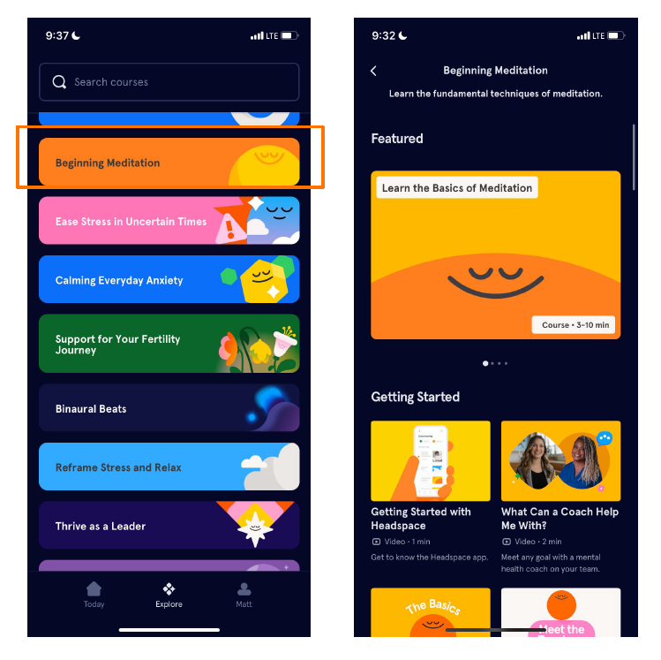
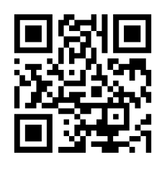
Headspace
All Jackson employees (and 5 of their family members) have free premium access to the Headspace application.
Offering more than 1,000 hours of content designed to help manage stress & anxiety, get more restful sleep, exercise mindfully, remain focused and more!
Also includes kid-friendly modules in partnership with “Cocomelon” and healthy nutrition content.
Scan here to get started

Slide 12

NAMI – Mental Health
As part of our commitment to our employees, we are proud to support the National Alliance on Mental Illness (NAMI) and their incredible work in advocacy, education, and access to mental health resources.
NAMI HelpLine is available Monday through Friday, 10 a.m. – 10 p.m. Call 800-950-6264, text “NAMI” to 62640, or email: helpline@nami.org
In a crisis, call or text: 988 (available 24/7)

Slide 13
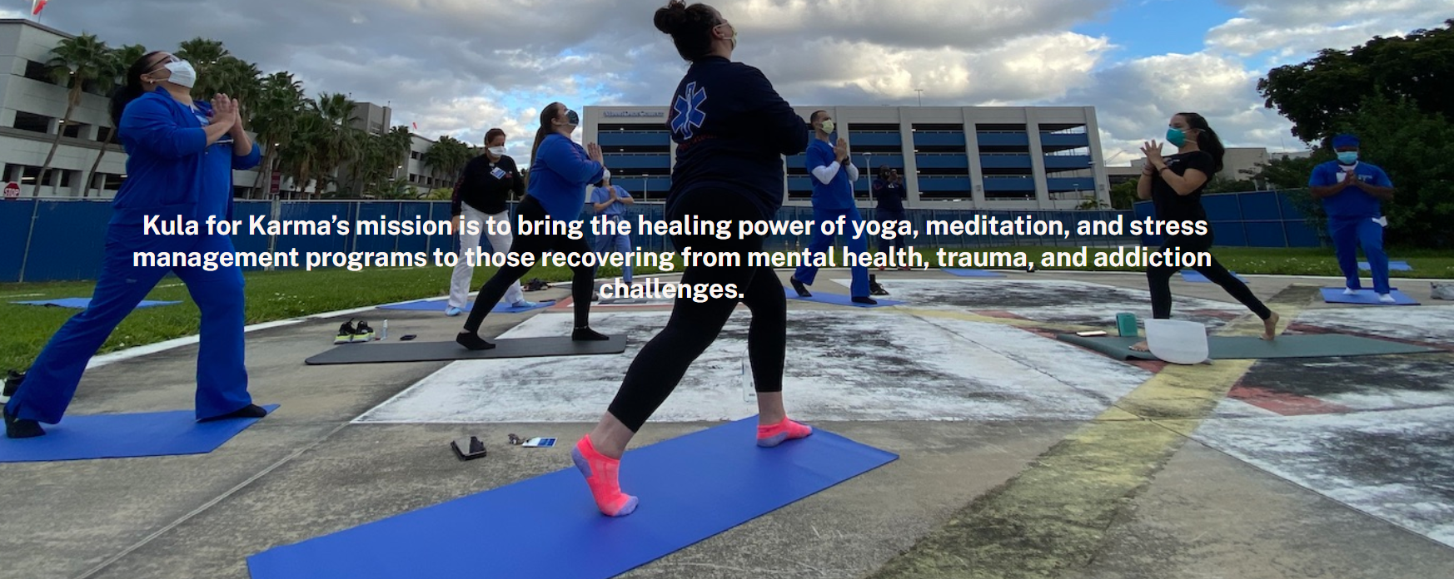

Kula for Karma
Employees can enjoy free monthly virtual meditation, on the third Wednesday of every month. Link found on JacksonBenefits.org

Slide 14

Systemwide Zen Dens
Jackson North: 2nd Floor Zen Room
Holtz: Tranquility Room # 7077
Lynn Rehab: 3rd Floor Tranquility Room
Ryder Trauma: T448
Jackson West: 4th Floor Tranquility Room
Behavioral Health: 2048

Slide 15
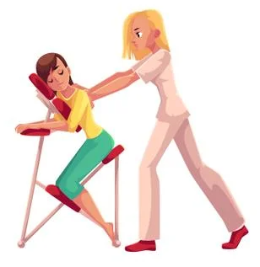

Wellness on Wheels
Bringing Wellness to the Units!
Wellness Wednesdays, third Wednesday of every month, hosting in unit chair massages in addition to CARE on Call counselors for either group therapy or one on one sessions as desired.

Slide 16



Contact Us
For more information, please contact your benefits team at
HR-Benefits@jhsmiami.org or 786-466-2970.
JacksonBenefits.org

