Slide 1
Jackson Wellness Resources
Leader Toolkit

Slide 2
Recognizing Distress Among Employees
Early Signs of Distress
Person seems different
Behavior
Job performance
Motivation
Concentration
Symptoms Interfering with Daily Functioning
Trouble completing daily tasks
Difficulty performing at work
Withdrawal from others
Mental Health Crisis
Behavior that puts the person or others in danger
Overdose
Threat of suicide
Inability to care for others who may depend on him or her

Slide 3
Remember to “CARE”
Consider the signs
Ask to talk
Refer to resources
Engage in follow-up
What are some of those resources?

Slide 4
Employee Assistance Program - EAP
What is Resources for Living?
A starting place for addressing personal issues
A cost-free avenue of assistance to support a healthy workplace
Includes access to counseling services, work-life services such as childcare referrals, legal, and financial services, and more
Services are confidential and are not shared with your employer. There are certain required-by-law exceptions:
If a caller reports any knowledge or suspicion of child or elder abuse or neglect
If a caller threatens to harm themselves or others
When the caller signs a release of information granting permission to divulge certain information

Slide 5
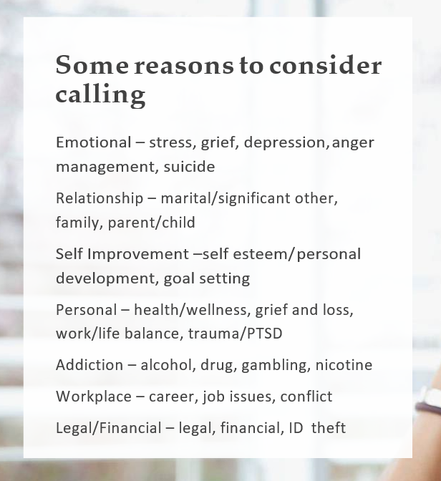
Employee Assistance Program - EAP
Eligibility
Who’s eligible?
You (first day of hire)
Anyone in your household (regardless of their relationship to you, age, or health insurance coverage)
Dependents up to age 26 whether or not they live at home

Slide 6
Employee Assistance Program - EAP
Life and Relationships
Resource Centers
Career and Workplace
Parenting
Relationships
Aging adults
Balancing work and family
Managing life
Pets
Crisis and disaster
Staying healthy
Fitness
Nutrition
Self-improvement
Stress
Trauma, grief, and loss
Dealing with tough situations
Handling change
Helping your coworkers
Navigating career
Manager resources
Manager services
Mental Health and Addictions
Tools
Depression
Suicide prevention
Addictions
Mental health awareness and conditions
Mental well-being terms
Services
Monthly features
Webinars
Video library
Digital resources
Find support
Check in on you
About your benefits
Orientation
Emotional well-being
Legal and financial
Daily life assistance

Slide 7
Employee Assistance Program - EAP
Resource Services
Unlimited telephonic consultation with the Organizational Risk Management Center (ORMC). Speak to a clinically licensed management consultant for employee and workplace concerns
Performance issues
Substance misuse
Policy violations
Harassment
Mergers, layoffs, acquisitions, and more
Training and education
Conflict resolution and mediation services
Crisis support

Slide 8
Employee Assistance Program - EAP
How to Spot Troubled Employees
Lateness
Absenteeism
Poor concentration
Decreased productivity
Unusual behavior
Increased mistakes and/or accidents
Friction with co-workers
Difficulty learning from mistakes
Excessive time on phone
Lying
Negative attitude

Slide 9
Employee Assistance Program - EAP
Suggesting Our Services
Consider a Management Referral
Suggest your employee call us when:
You become aware of an employee’s personal issue
No job performance concerns exit
You want to offer proactive support
The process:
Provide employees with our contact information
No release of information is signed
You receive no communication regarding employee follow-up for treatment
Use a management referral when:
An employee has performance issues or
An employee’s behavior creates risk or liability for your organization
The process:
Call to consult with an MRC to determine how to proceed
Meet with the employee and signa. HIPAA release of information that you return to the MRC
Get follow-up information, which may include employee’s level of participation and attendance

Slide 10
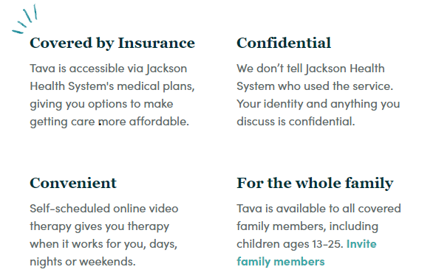
Tava: Mental Health Benefit
How Tava Works
Find the Perfect Fit: Get therapist recommendations based on your needs and preferences, or browse detailed therapist profiles until you find someone you’re comfortable with.
Meet When and Where You Want: Schedule an appointment in a few clicks, then meet your therapist anywhere you can connect to the web.
Feel Better: 92 percent of Tava clients report improved mental health after just four sessions. We’re confident you will, too.

Slide 11
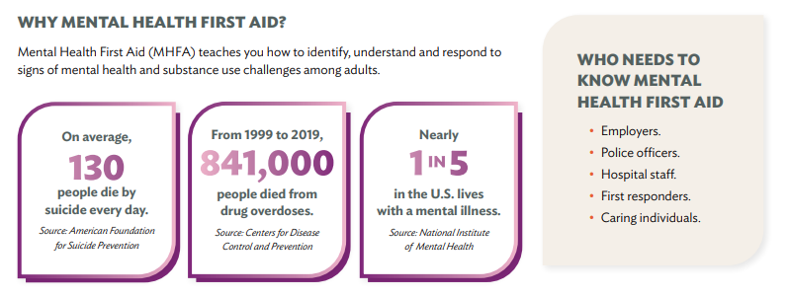
Mental Health First-Aide Training
Eight-hour training course offered by the Jewish Community Service, free of cost for all Jackson employees.
Covers common signs and symptoms of mental health challenges, how to interact with a person in crisis, how to connect a person with help, among other topics.

Slide 12
AvMed: WellFluent Living Program
Online Wellness Portal powered by HealthyRoads: Online Classes, Resources, and Self-Management Tools
Active & Fit Program: Discounted Fitness Program Membership with access to more than 11,000 fitness centers
Weight Watchers Program with a discounted rate and reimbursement for eligible participants.

Slide 13
Optum via AvMed : Behavioral Health
Mental Health and Substance Disorders – Adult, Adolescent and Child
Outpatient treatments rendered in a residential treatment facility are limited to 60 days per year. There are no limits on regular outpatient visits. As well as helpline, 24 hours a day, or visit liveandworkweel.com/recovery (available to family as well).
Medication Assisted Treatment (MAT)
Emotional Health Line 24/7: specialists will talk through concerns about: Family and relationships, financial stress, anxiety and depression, other emotional challenges.
Live and Work Well
24/7 access to LiveandWorkWell.com
Search for a mental health provider
Find mental health providers who offer online counseling, called virtual visits
Get personalized support
Look up information about conditions, plus find screening tools, articles, videos, self-help programs and more resources

Slide 14
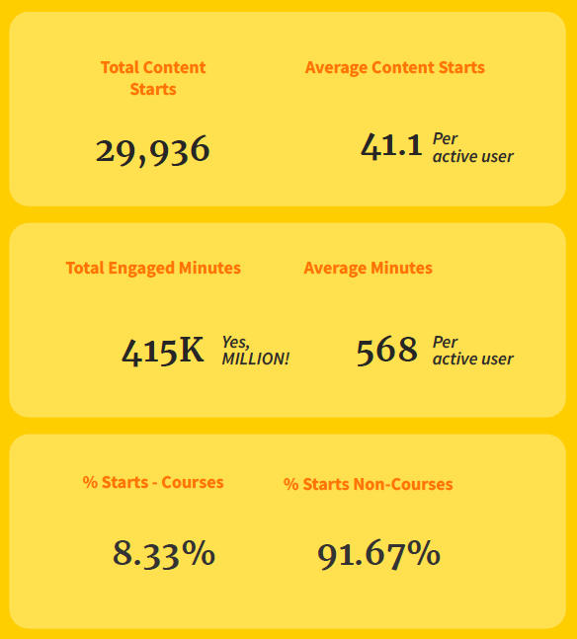
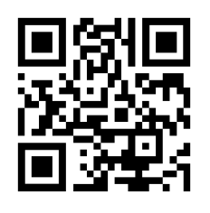
Headspace
All Jackson employees have free premium access to the Headspace application.
Offering more than 1,000 hours of content designed to help manage stress & anxiety, get more restful sleep, exercise mindfully, remain focused and more!
Also includes kid-friendly and healthy nutrition content.

Slide 15
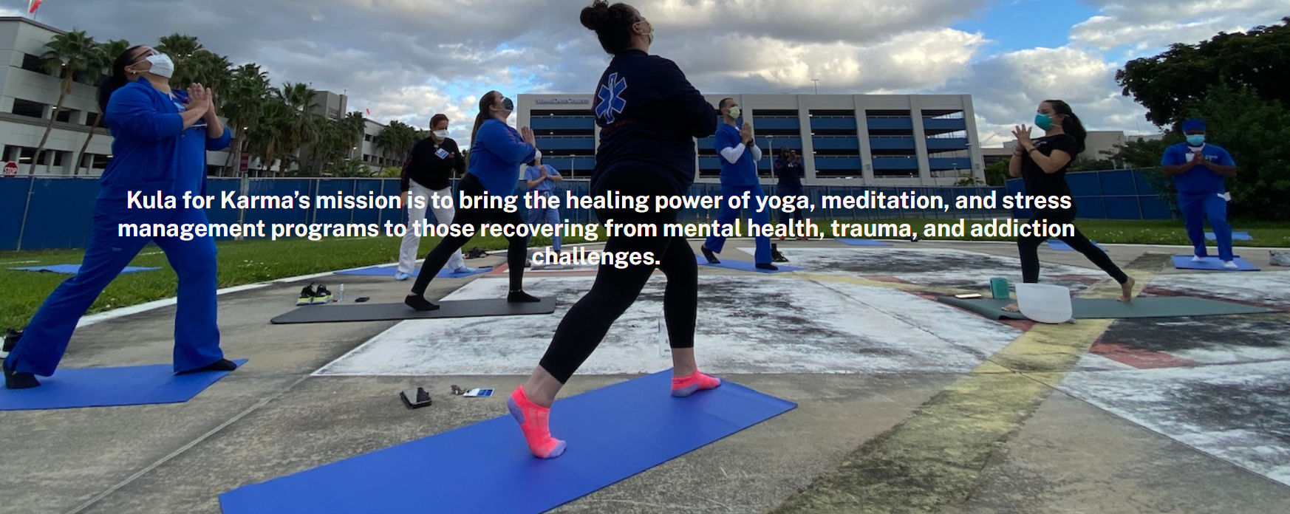
Kula for Karma
Employees can enjoy weekly virtual meditation or monthly virtual yoga.
Links found on JacksonBenefits.org

Slide 16
Systemwide Zen Dens
Jackson North: Room #202
Ryder Trauma: T448
Holtz: Tranquility Room # 7077
Lynn Rehab: 3rd Floor Tranquility Room
Jackson South: 1st Floor, Old ID Badge Room
Jackson West: 4th Floor Tranquility Room
Behavioral Health: Coming Soon!

Slide 17
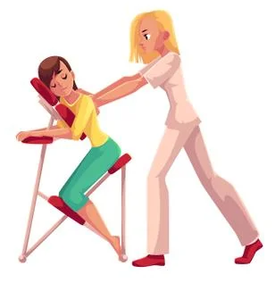
Wellness on Wheels
Bringing Wellness to the Units!
Wellness Wednesdays, third Wednesday of every month, hosting in unit chair massages in addition to EAP counselors for either group therapy or one on one sessions as desired.

Slide 18
Contact Us
For more information, please contact your benefits team at HR-Benefits@jhsmiami.org or 786-466-2970.
JacksonBenefits.org

